Slide 1
Markov and Chebyshev’s inequality, Central Limit Theorem and Conditional probability and conditional expectation

Slide 2
What do you think?
I toss a coin 1000 times. The probability that I get 14 consecutive heads is
A
B
C
< 10%
≈ 50%
> 90%

Slide 3
Consecutive heads
Let N be the number of occurrences of 14 consecutive heads in 1000-coin flips.
N = I₁ + … + I₉₈₇
where I_{i} is an indicator r.v. for the event
“14 consecutive heads starting at position i”
E[I_{i} ] = P(I_{i} = 1) = 1/2¹⁴
E[N ] = 987 ⋅ 1/2¹⁴
= 987/16384
≈ 0.0602

Slide 4
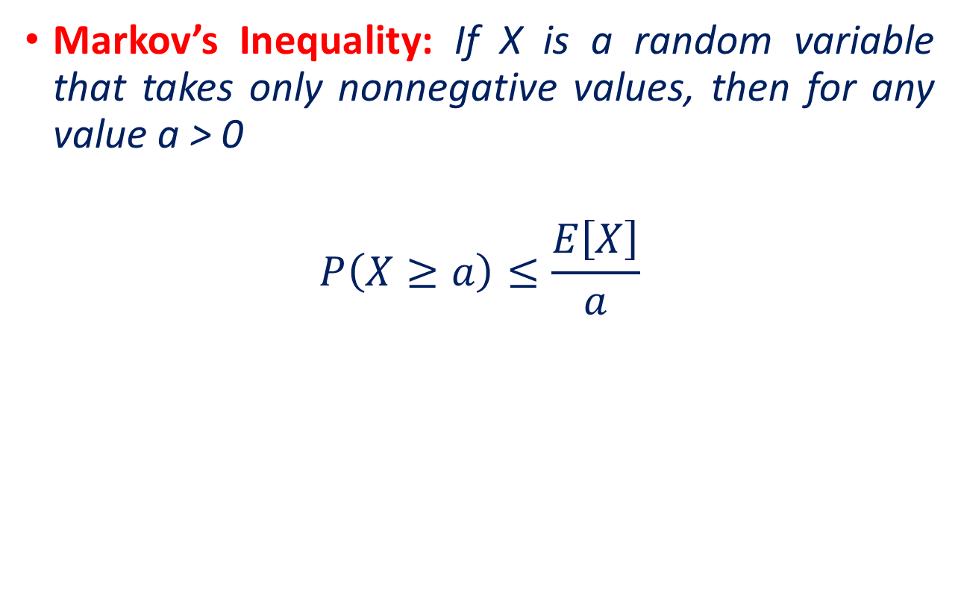
Limit Theorems
Markov’s Inequality: If X is a random variable that takes only nonnegative values, then for any value a > 0
$$P\left(X≥a\right)≤\frac{E\left[X\right]}{a}$$
E[N ] ≈ 0.0602
P[N ≥ 1] ≤ E[N ] / 1 ≤ 6%.

Slide 5
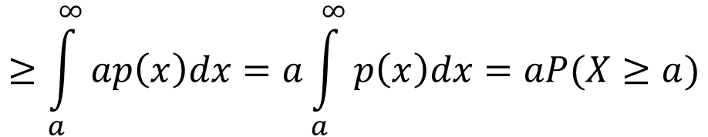
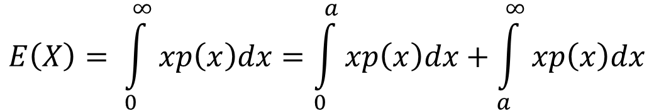
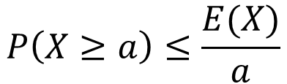
Proof of Markov’s inequality
For every non-negative random variable X: and every value a:
P(X ≥ a) ≤ E[X] / a.
$$E\left(X\right)= \int_{0}^{∞}{xp\left(x\right)dx}=\int_{0}^{a}{xp\left(x\right)dx}+\int_{a}^{∞}{xp\left(x\right)dx}$$
$$≥\int_{a}^{∞}{ap\left(x\right)dx}=a\int_{a}^{∞}{p\left(x\right)dx}=aP(X≥a)$$
$$P\left(X≥a\right)≤\frac{E(X)}{a}$$

Slide 6
Example
1000 people throw their hats in the air. What is the probability at least 100 people get their hat back?
Solution
N = I₁ + … + I₁₀₀₀
where I_{i} is the indicator for the event that person i gets their hat. Then E[I_{i} ] = P(I_{i} = 1) = 1/n
E[N ] = n 1/n = 1
P[N ≥ 100] ≤ E[N ] / 100 = 1%.

Slide 7
What do you think?
Suppose we know that the number of items produced in a factory during a week is a random variable with mean 500.
If the variance of a week’s production is known to equal 100, then what can be said about the probability that this week’s production will be between 400 and 600?

Slide 8
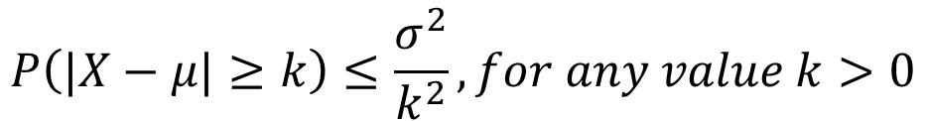
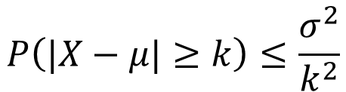
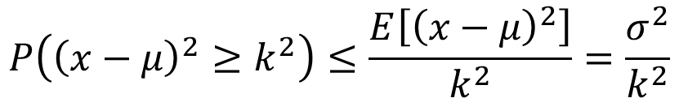
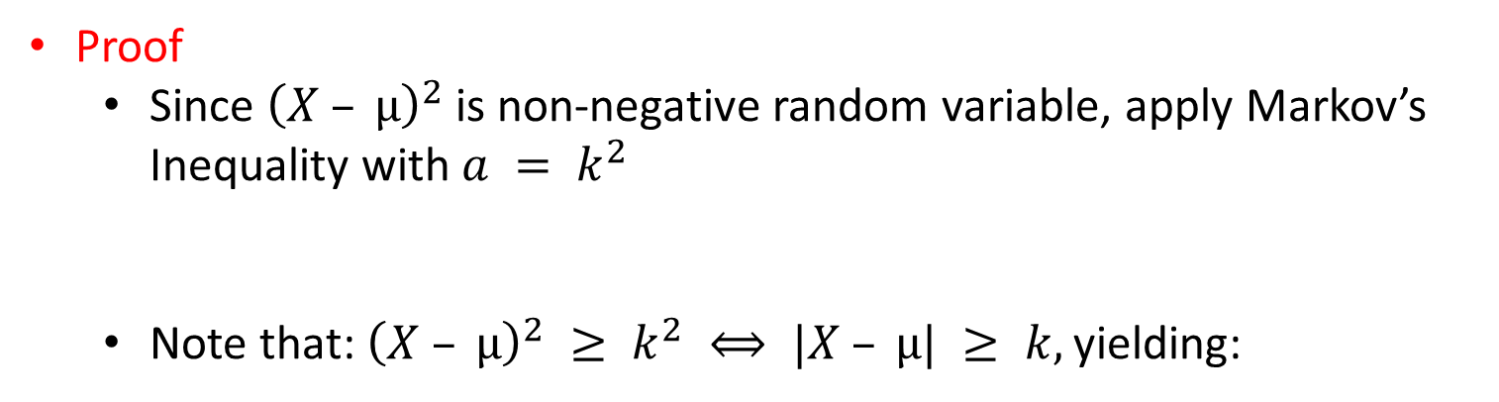
Chebyshev’s Inequality
What is the probability that the value of X is far from its expectation?
Let X be a random variable with $E[X] = µ, Var(X) =σ^{2}$
$$P\left(|X−μ|≥k\right)≤\frac{σ^{2}}{k^{2}},for any value k>0$$
Proof
Since ${\left(X – µ\right)}^{2}$is non-negative random variable, apply Markov’s Inequality with $a = k^{2}$
Note that: ${\left(X – µ\right)}^{2} ≥ k^{2} ⟺ |X – µ| ≥ k,$yielding:
$$P\left({\left(x−μ\right)}^{2}≥k^{2}\right)≤\frac{E\left[{\left(x−μ\right)}^{2}\right]}{k^{2}}=\frac{σ^{2}}{k^{2}}$$
$$P\left(|X−μ|≥k\right)≤\frac{σ^{2}}{k^{2}}$$
Markov’s and Chebyshev’s inequalities enable us to derive bounds on probabilities when only the mean, or both the mean and the variance, of the probability distribution are known.

Slide 9
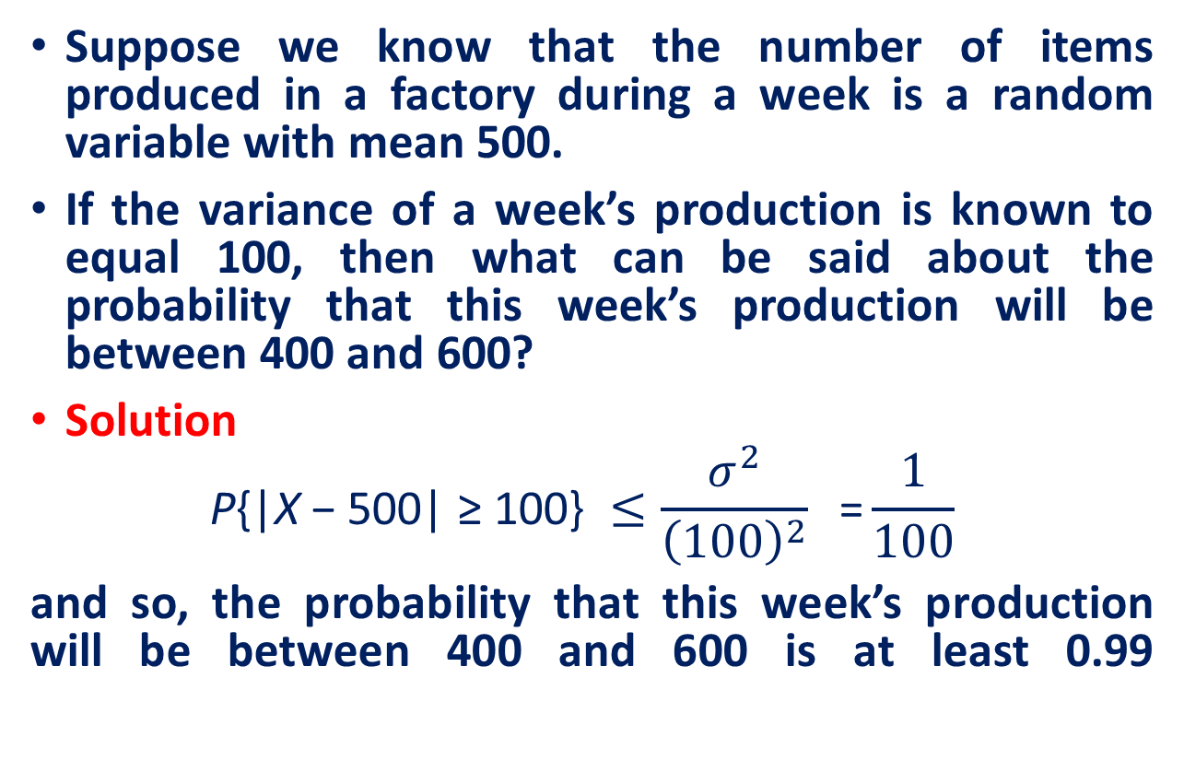
What do you think?
Suppose we know that the number of items produced in a factory during a week is a random variable with mean 500.
If the variance of a week’s production is known to equal 100, then what can be said about the probability that this week’s production will be between 400 and 600?
Solution
$$\text{P}\text{\{|}\text{X} \text{− 500| ≥ 100\} }≤\frac{σ^{2}}{{\left(100\right)}^{2}} \text{ =}\frac{1}{100}$$
and so, the probability that this week’s production will be between 400 and 600 is at least 0.99

Slide 10
Central Limit Theorem
Recall
Observation
Result from one trial of an experiment.
Sample
Group of results gathered from separate independent trials.
Population
Space of all possible observations that could be seen from a trial.
If we calculate the mean of a sample, it will be an estimate of the mean of the population distribution.
But, like any estimate, it will be wrong and will contain some error.
If we draw multiple independent samples, and calculate their means, the distribution of those means will form a Gaussian distribution.

Slide 11
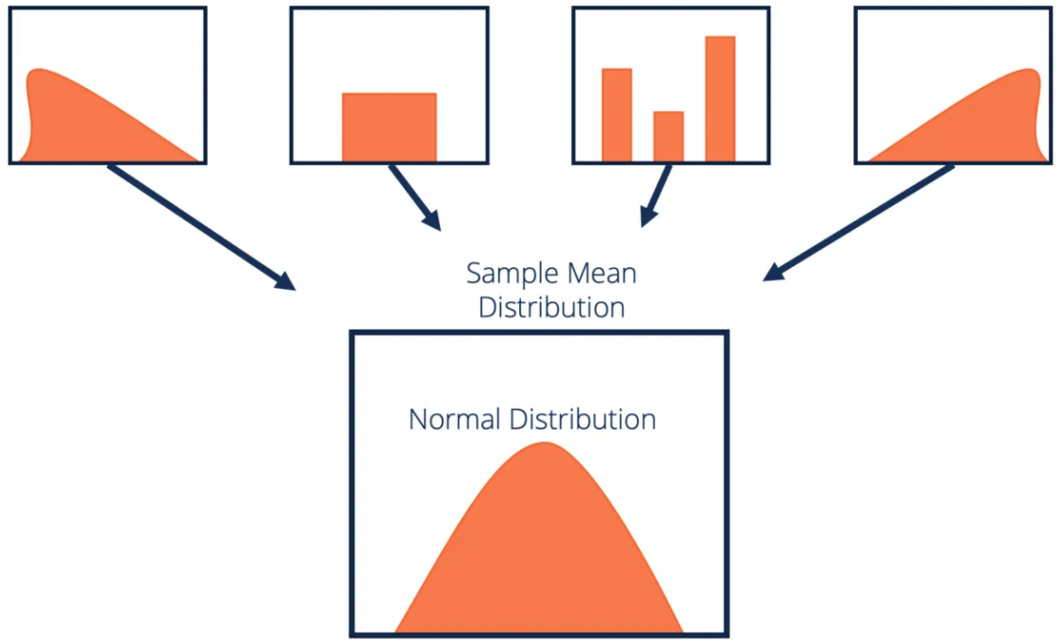
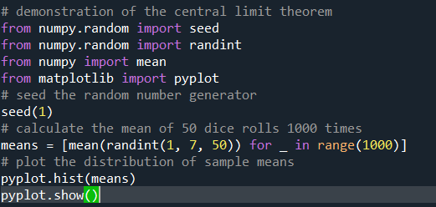
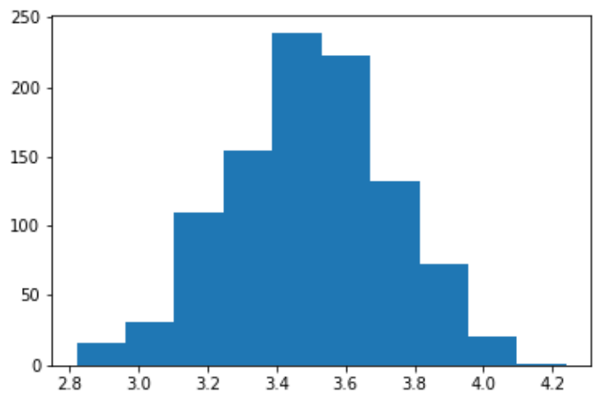

Central Limit Theorem
The central limit theorem states that if you have a population with mean $μ$ and standard deviation $σ$and take sufficiently large random samples from the population with replacement, then the distribution of the sample means will be approximately normally distributed.

Slide 12
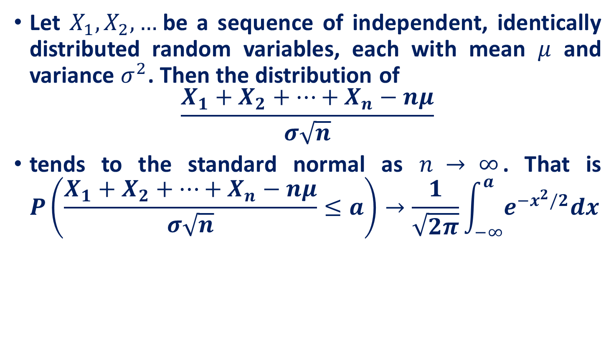
Central Limit Theorem
Let $X_{1}, X_{2}, …$be a sequence of independent, identically distributed random variables, each with mean $μ$ and variance $σ^{2}$. Then the distribution of
$$\frac{X_{1}+X_{2}+…+X_{n}−nμ}{σ\sqrt{n}}$$
tends to the standard normal as $n → ∞$. That is $P\left(\frac{X_{1}+X_{2}+…+X_{n}−nμ}{σ\sqrt{n}}≤a\right)→\frac{1}{\sqrt{2π}}\int_{−∞}^{a}{e^{−x^{2}/2}dx}$

Slide 13
Conditional probability and conditional expectation

Slide 14
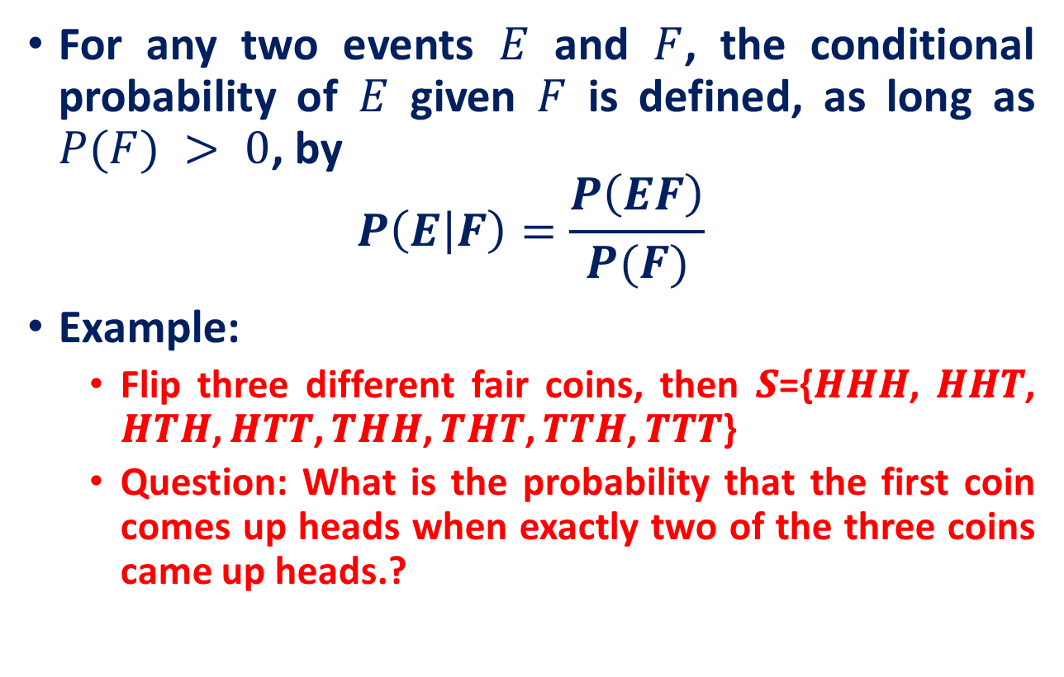
Recall: The Discrete Case
For any two events $E$ and $F$, the conditional probability of $E$ given $F$ is defined, as long as $P(F) > 0$, by
$$P\left(E | F\right)=\frac{P\left(EF\right)}{P(F)}$$
Example:
Flip three different fair coins, then 𝑺={𝑯𝑯𝑯, 𝑯𝑯𝑻, 𝑯𝑻𝑯, 𝑯𝑻𝑻, 𝑻𝑯𝑯, 𝑻𝑯𝑻, 𝑻𝑻𝑯, 𝑻𝑻𝑻}
Question: What is the probability that the first coin comes up heads when exactly two of the three coins came up heads.?

Slide 15
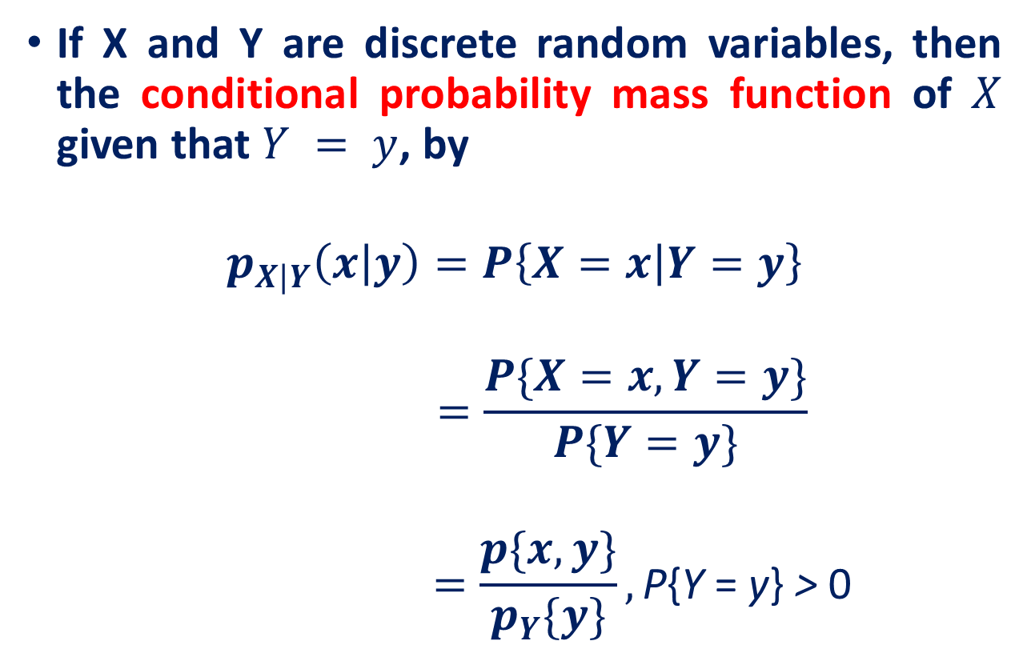
The Discrete Case
If X and Y are discrete random variables, then the conditional probability mass function of $X$ given that $Y = y$, by
$$p_{X|Y}\left(x | y\right)=P\left\{X=x | Y=y\right\}$$
$$=\frac{P\{X=x,Y=y\}}{P\{Y=y\}}$$
$$=\frac{p\{x,y\}}{p_{Y}\{y\}},\text{P}\text{\{}\text{Y} \text{= }\text{y}\text{\} }\text{> }\text{0}$$

Slide 16
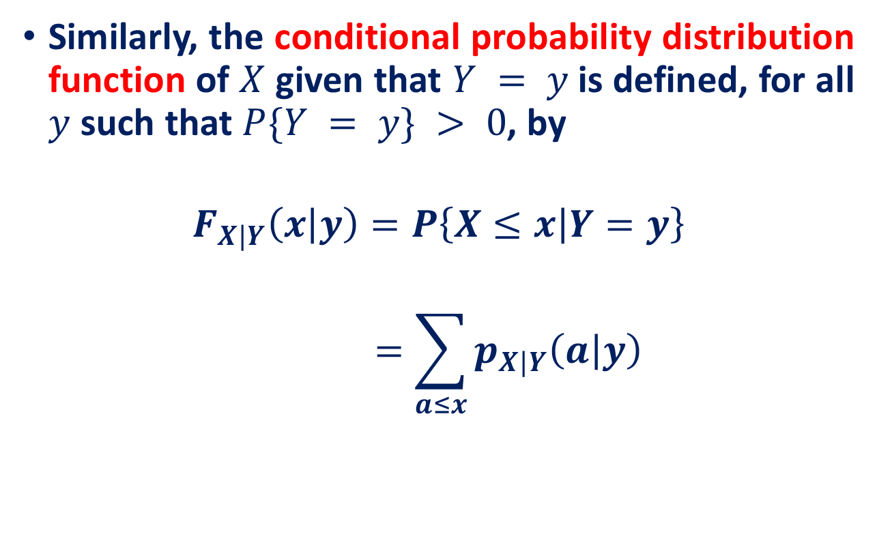
The Discrete Case
Similarly, the conditional probability distribution function of $X$ given that $Y = y$is defined, for all $y$ such that $P\{Y = y\} > 0$, by
$$F_{X|Y}\left(x | y\right)=P\left\{X≤x | Y=y\right\}$$
$$=\sum_{a≤x}{p_{X|Y}\left(a | y\right)}$$

Slide 17
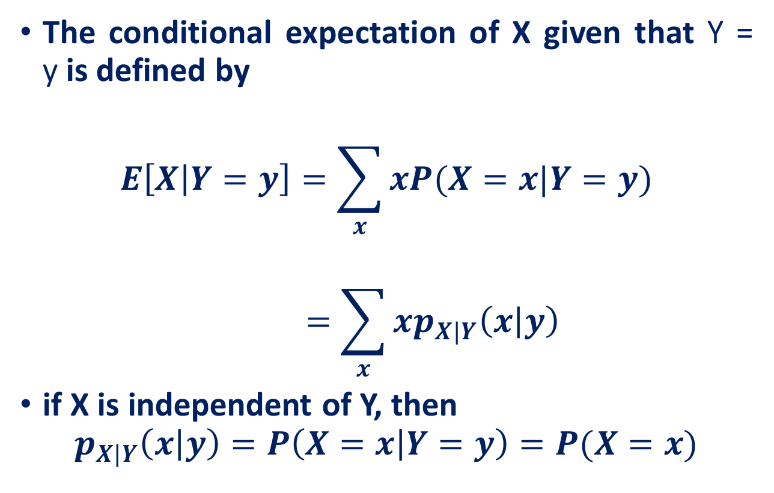
The Discrete Case
The conditional expectation of X given that Y = y is defined by
$$E\left[X | Y=y\right]=\sum_{x}{xP(X=x|Y=y)}$$
$$=\sum_{x}{xp_{X|Y}\left(x | y\right)}$$
if X is independent of Y, then
$$p_{X|Y}\left(x | y\right)=P\left(X=x | Y=y\right)=P(X=x)$$

Slide 18

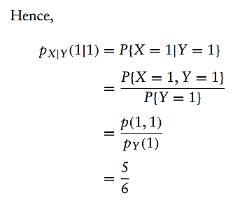
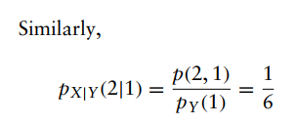
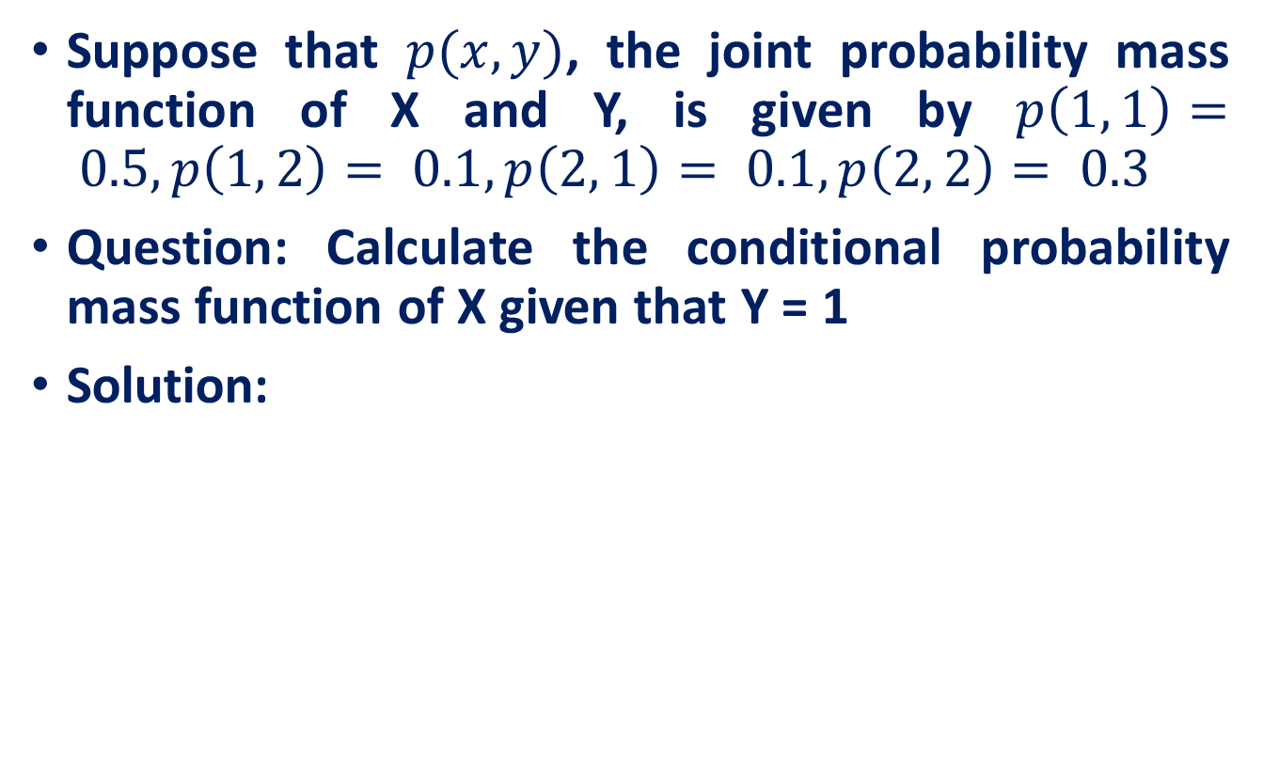
Example
Suppose that $p(x, y)$, the joint probability mass function of X and Y, is given by $p\left(1, 1\right)= 0.5, p\left(1, 2\right)= 0.1, p\left(2, 1\right)= 0.1, p\left(2, 2\right)= 0.3$
Question: Calculate the conditional probability mass function of X given that Y = 1
Solution:

Slide 19
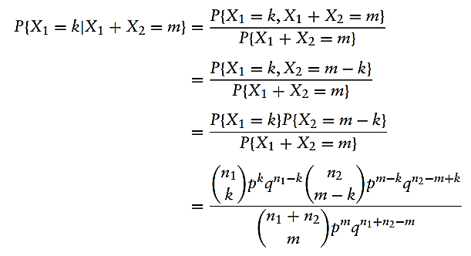
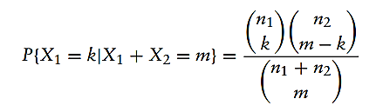

Example
If $X_{1}$ and $X_{2}$ are independent binomial random variables with respective parameters $(n_{1}, p)$and $(n_{2}, p),$calculate the conditional probability mass function of $X_{1}$ given that $X_{1} + X_{2} = m$.

Slide 20
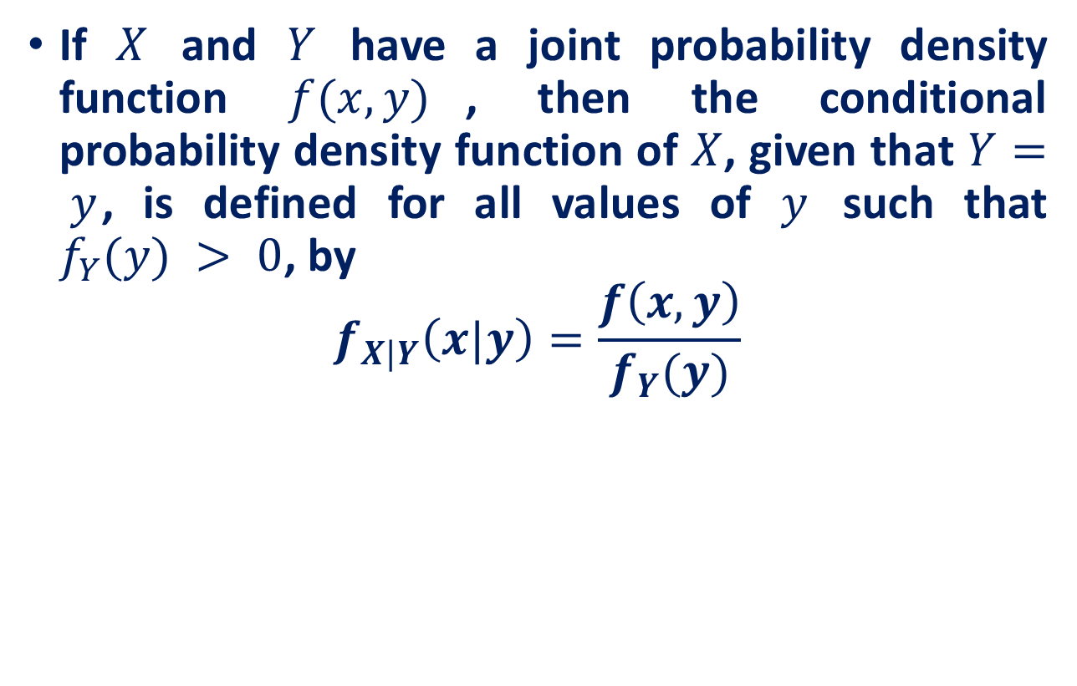
The Continuous Case
If $X$ and $Y$ have a joint probability density function $f(x, y)$, then the conditional probability density function of $X$, given that $Y= y$, is defined for all values of $y$ such that $f_{Y}(y) > 0$, by
$$f_{X|Y}\left(x|y\right)=\frac{f\left(x,y\right)}{f_{Y}(y)}$$

Slide 21
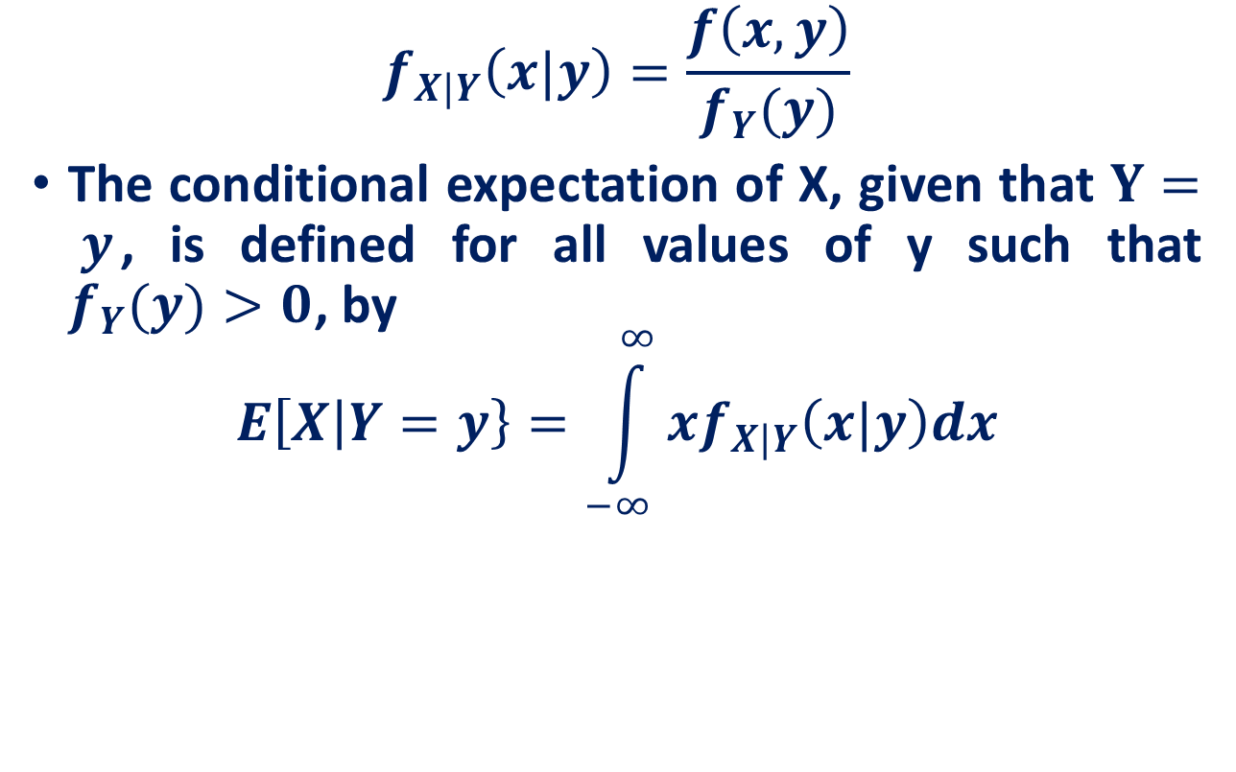
The Continuous Case
$$f_{X|Y}\left(x|y\right)=\frac{f\left(x,y\right)}{f_{Y}(y)}$$
The conditional expectation of X, given that $Y= y$, is defined for all values of y such that $f_{Y}(y)>0$, by
$$E\left[X | Y=y\right\}=\int_{−∞}^{∞}{xf_{X|Y}\left(x|y\right)dx}$$

Slide 22
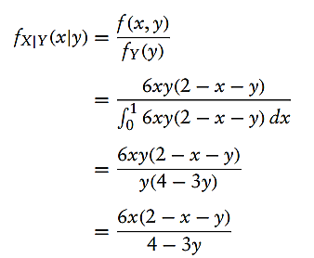
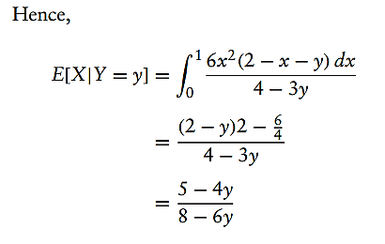

Example
Suppose the joint density of X and Y is given by
$$f\left(x,y\right)=f\left(x\right)=\left\{\begin{aligned}6xy\left(2−x−y\right), 0<x<1,0<y<1 \\ &0, otherwise\end{aligned}\right.$$
Question: Compute the conditional expectation of X given that $Y = y$, where $0 < y < 1$.

Slide 23
Reference
Lecture notes on Probability Theory by Phanuel Mariano
Introduction to Probability Models, Sheldon M. Ross, Tenth Edition

